Slide 1
AcademiaPlus
An Academic Management System.....
Presenter:
Suman Khatri
and
Chitra Bahadur Thapa

Slide 2
Table of Contents
Introduction
Problem Statement
Objective
Limitation
Methodology
Tools Used
Gantt Chart
Conclusion
ScreenShort

Slide 3
Introduction
An Academic Management System is a digital platform designed to optimize the administrative and academic functions of educational institutions.

Slide 4
Problem Statement
Attendance Management
Marks Management
Class Managemet

Slide 5
Objectives
Enhance attendance tracking with an automated system for teachers and students.
Simplify class scheduling through a centralized routine management feature.
Provide transparent marks handling for students to access grades and feedback.

Slide 6
Limitations
Technical Constraints: Potential server downtime and software bugs.
User Adaptation: Users may struggle to adapt to the new system.
Data Security Risks: Possibility of data breaches despite security measures.
Scalability Issues: Performance may degrade with a growing user base.

Slide 7
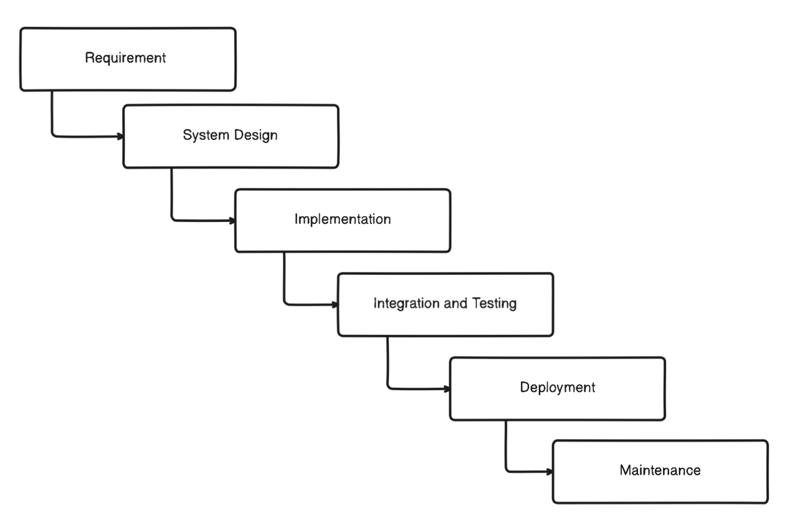
Methodology

Slide 8
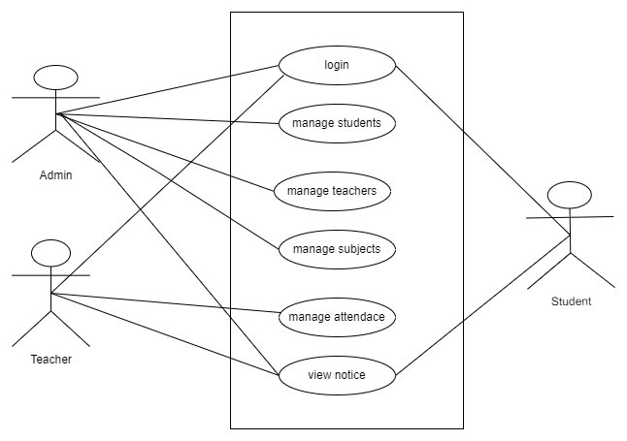
UseCase

Slide 9
Tools Used
Frontend | React, Material-Ui, Redux
Backend | Node.js, Express.js
Database | MongoDB(NoSQL databae)

Slide 10
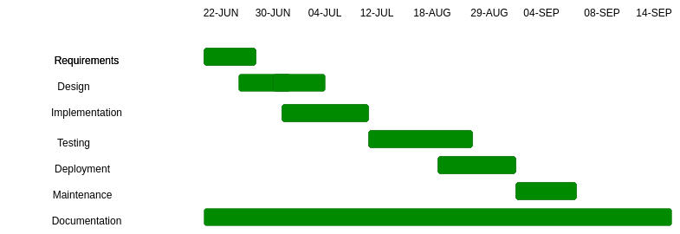
Gantt Chart

Slide 11
Conclusion
The development of an Academic Management System using modern technologies like React, Node.js, Express, MongoDB, and JWT authentication provides an efficient, scalable, and secure solution for managing the various aspects of academic institutions.

Slide 12
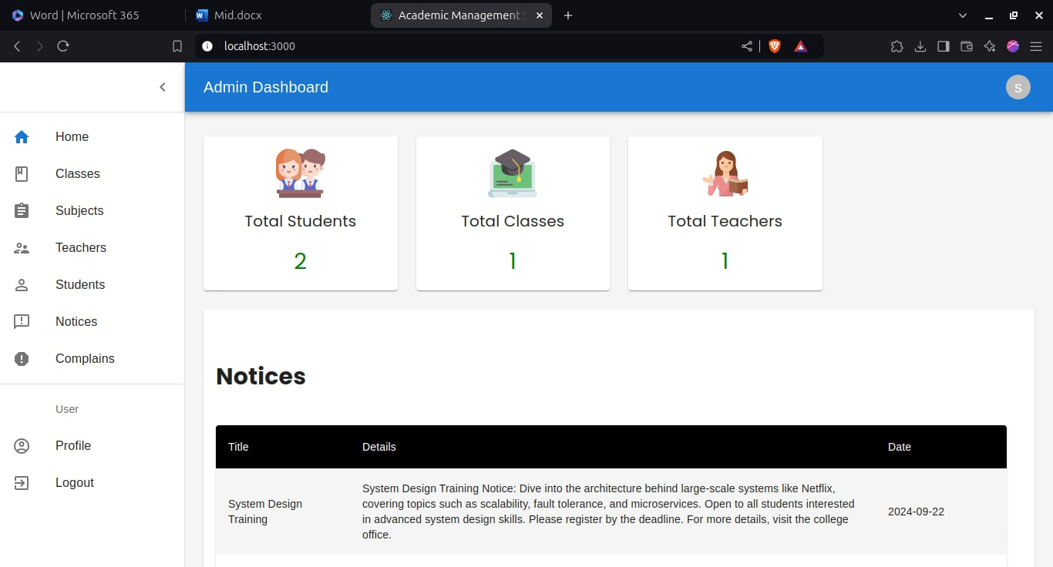
Screenshots
Dashboard (Admin)
Add a little bit of body text

Slide 13
Dashboard (Student)

Slide 14
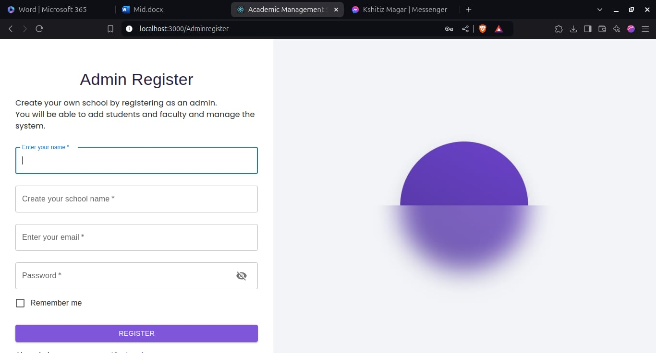
Admin Register

Slide 15
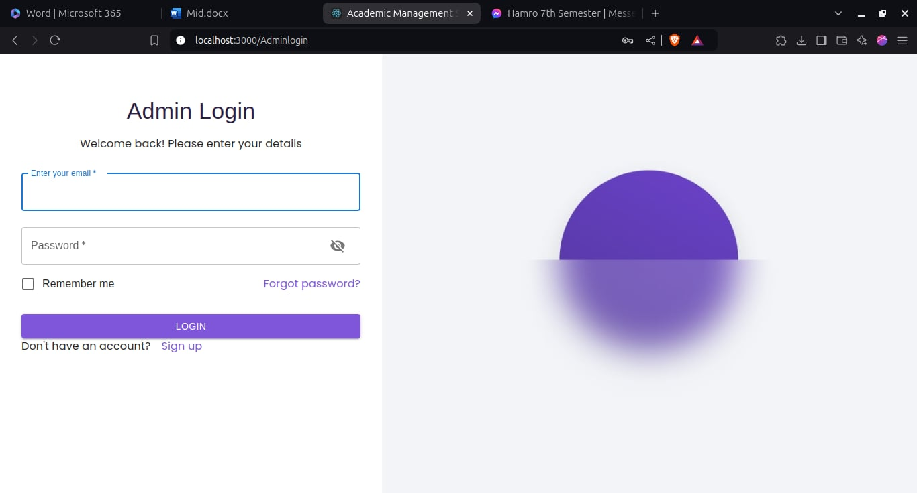
Admin Login

